Slide 1
Git’n Pro with HTML/CSS

Slide 2
It’s Okay!
How do I do this again?
Flickr: welcometolearn

Slide 3
Admin Items

Slide 4
Where to Get Help
Practice, Practice, Practice: Work Individually or in Groups
Review In Class Material (Exercises and Slides): <<<<PROVIDE LINK HERE>>>>>
Re-Watch Class Videos: <<<<PROVIDE LINK HERE>>>>>
In Class Office Hours: 45 minutes before class, 30 minutes after
One-on-One Sessions: By Announcement through SSM
Contact Student Success: Anytime!

Slide 5
Homework #1 - Assignment
Also, at this point everyone should have access to the homework repository in GitHub. <<<<< LINK HERE>>>>
Homework Assignment #1 is due next week
MW Class: Next Wednesday (<<<<DATE HERE>>>>)
TTH Class: Next Thursday (<<<<DATE HERE>>>>)

Slide 6
Today’s Class!

Slide 7
Today’s Objectives
Students will understand the importance of Git Version Control and of how to use it.
Students will create GitHub Repositories, push code into them, and share with class.
Students will make more HTML documents.
Students will learn to properly use basic HTML tags.
Students will implement basic CSS styling to HTML documents.

Slide 8
Know Thyself
If you are a complete beginner to HTML/CSS and Coding:
Continue getting comfortable with HTML.
Be able to completely write a basic HTML document (like in last class).
Understand what CSS is, what it’s for, and how it works with HTML.
Be able to use Git and GitHub to upload code.
If you’ve had past exposure and felt comfortable with the last lesson:
Aim to build up your skills. Clear up any questions or confusions about HTML.
Become knowledgeable about a wider range of HTML and CSS tags.
Be able to selectively apply CSS to specific HTML elements.
Be able to use Git and GitHub to upload code.

Slide 9
What / Why Git?

Slide 10
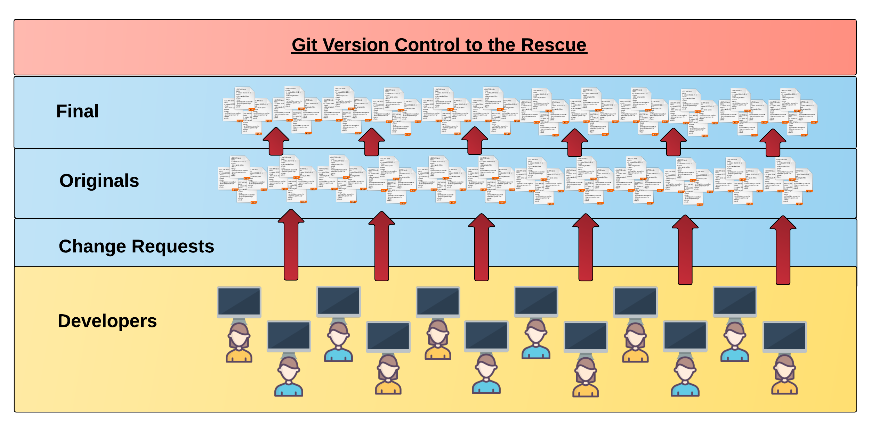
Collaborative Coding
Modern web development is highly collaborative.
Teams are often extremely large and separated across the country — or planet.
Apps sometimes comprise hundreds or even thousands of files.

Slide 11
The Team’s Task
Task: Make a list of creative works you’ve written in the past
Programming Team:
Maya Angelou
Anne Sexton
Gil Scott Heron

Slide 12

Maya & Gil make their edits
Programming Away…
Maya’s Version
Programming Away…
Gil’s Version

Slide 13
Different Solutions
<ul>
<li>On the Pulse of Morning</li> <li>I Know Why the Caged Bird Sings</li> <li>And Still I Rise</li>
</ul>
Different
<ul>
<li>Free Will</li> <li>Pieces of a Man</li> <li>The Revolution will not be Televised</li>
</ul>

Slide 14
Resolution
<ul>
<li>On the Pulse of Morning</li> <li>I Know Why the Caged Bird Sings</li> <li>And Still I Rise</li>
</ul>
“Let’s settle on this…”
<ul>
<li>Poems</li> <li>Albums</li> <li>Songs</li>
</ul>
<ul>
<li>Free Will</li> <li>Pieces of a Man</li> <li>The Revolution will not be Televised</li>
</ul>

Slide 15
Anne writes her own stuff…
<ul>
<li>The Double Image</li> <li>Heart’s Needle</li> <li>Baby Picture</li>
</ul>

Slide 16
Anne overwrites work of her teammates…
Delete. Delete. Delete. Delete.
Delete. Delete
<ul>
<li>Poems</li> <li>Albums</li> <li>Songs</li>
</ul>
<ul>
<li>The Double Image</li> <li>45 Mercy Street</li> <li>The Road Back</li>
</ul>

Slide 17
The Group Project
Lesson:
You should use Version Control.
….and watch your teammates’ work
Today we fret and pull on wheels, ignore our regular loss of time…
…or maybe we should just use git

Slide 18
Version Control
Git Version Control: Provides a organized system for managing code for when multiple developers work on a project
at the same time.
The Benefits of Git:
A process for resolving conflicts in code.
Version History.

Slide 19
The Group Project
Master Branch
‘Branch’ = personal copy
Personal branch
Maya’s branch
Anne’s branch
Gil’s branch

Slide 20
The team goes to work
<ul>
<li>On the Pulse of Morning</li> <li>I Know Why the Caged Bird Sings</li> <li>And Still I Rise</li>
</ul>
<ul>
<li>Free Will</li> <li>Pieces of a Man</li> <li>The Revolution will not be Televised</li>
</ul>

Slide 21
Maya pushes first
Master Copy
1
Maya pushes (uploads) her code changes into the main branch.
No code conflicts.
Maya’s Branch

Slide 22
Gil’s edits are ready
Rule: pull first, then push your changes
Ok

Slide 23
Gil pulls latest changes
Master Copy
1
Gil’s Branch

Slide 24
Gil conflicts with master branch
Master Branch
1
<li>On the Pulse of Morning</li> <li>I Know Why the Caged Bird Sings</li> <li>And Still I Rise</li>
<li>On the Pulse of Morning</li> <li>I Know Why the Caged Bird Sings</li> <li>And Still I Rise</li>
Git sees a conflict.

Slide 25
Kobe resolves
<ul>
<li>Poems</li> <li>Albums</li> <li>Songs</li>
</ul>
<li>On the Pulse of Morning</li> <li>I Know Why the Caged Bird Sings</li> <li>And Still I Rise</li>
<li>On the Pulse of Morning</li> <li>I Know Why the Caged Bird Sings</li> <li>And Still I Rise</li>
Gil’s Branch

Slide 26
Gil fixes and pushes
Master Branch
1
2
Gil pushes (uploads) his revision the main branch.
No code conflicts.
<ul>
<li>Poems</li> <li>Albums</li> <li>Songs</li>
</ul>
Gil’s Branch

Slide 27
Anne starts her work
Rule: pull first, then push your changes
look into my face and you will know that crimes dropped upon me
as from a high building…
…by which I mean, I broke the rules.

Slide 28
Anne pushes
Master Branch
1
2
3
Anne dude pushes (uploads) her revision the main branch. No code conflicts.
Not what we want.
<ul>
<li>The Double Image</li> <li>Heart’s Needle</li> <li>Baby Picture</li>
</ul>
Anne’s Branch

Slide 29
If Annehad made a pull first…
Conflict!
<ul>
<li>The Double Image</li> <li>Heart’s Needle</li> <li>Baby Picture</li>
</ul>
<ul>
<li>Poems</li> <li>Albums</li> <li>Songs</li>
</ul>

Slide 30
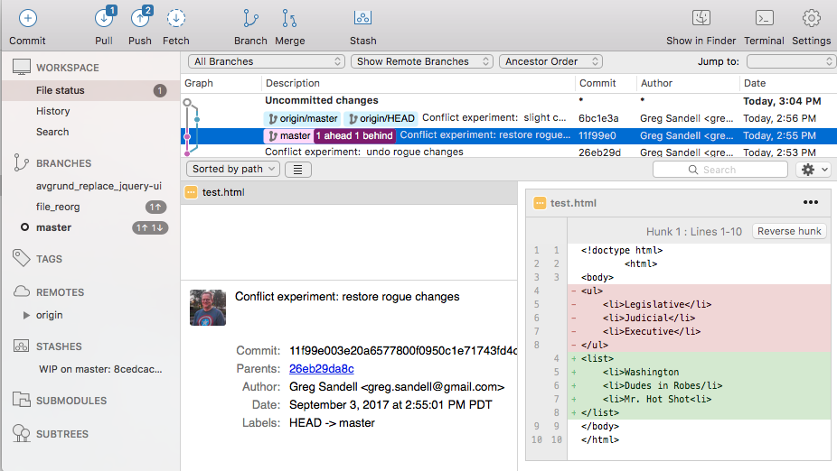
The overwritten work is discovered

Slide 31
Roll Back
Main Branch
1
2
3
4
Maya rolls back the code to an earlier version.
Anne’s Branch

Slide 32
The Group Project
Lesson:
You should use Version Control!

Slide 33
Quick Activity!
Suggested Time: 3 min
Turn to your neighbor, and have one of you explain to the other:
The concept of version control.
Then the other should explain:
Two of the key advantages to using a version control system.

Slide 34

So… What’s this GitHub?
GitHub is a Web-Based hosting service to store code online.
It allows developers to pull (download) code or push (upload) code to the same repository (directory).
It also allows developers to view histories of code changes and to track issues.

Slide 35

Pushing and Pulling to GitHub
1
2
3
4
GitHub Branch
Pull Code
Push Code
Pull Code
Pull Code
Push Code
Pull Code
Push Code

Slide 36
Get Started with Git

Slide 37
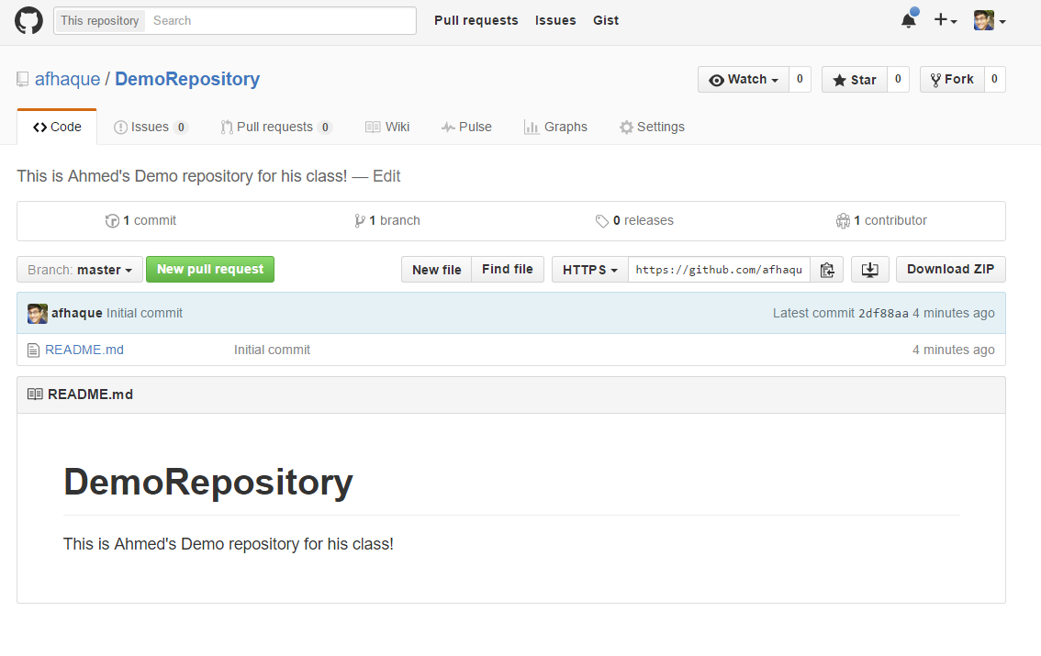
Instructor Git Demo!

Slide 38
Basic Git Commands
At its most basic, these are the five git commands to get started:
git clone
git add
git commit
git push
git pull

Slide 39
Basic Git Commands
At its most basic, these are the five git commands to get started:
git clone – copies an entire repo (to begin).
git add – adds a file for inclusion in Git.
git commit – notes a change to the local repo.
git push – sends changes to hosting service.
git pull – downloads freshest version of repo.

Slide 40
> YOUR TURN!
Activity: Git Add, Commit, Push | Suggested Time: 20 min
Assignment:
Using GitHub and the Command Line:
Create a new public GitHub repository and name it whatever you like. Be sure to check the box for “initialize this repository with a README.”
Next, clone the repo to your local directory.
Then create an HTML file inside the local directory.
Add, Commit, and Push the code to GitHub.
Bonus:
Find a partner in class, and fork their repository to your own GitHub account. Clone this forked repository to your local directory.
Add, Commit, and Push the code back to your forked copy.
Finally, submit a pull request to send your changes to your partner’s repo.

Slide 41
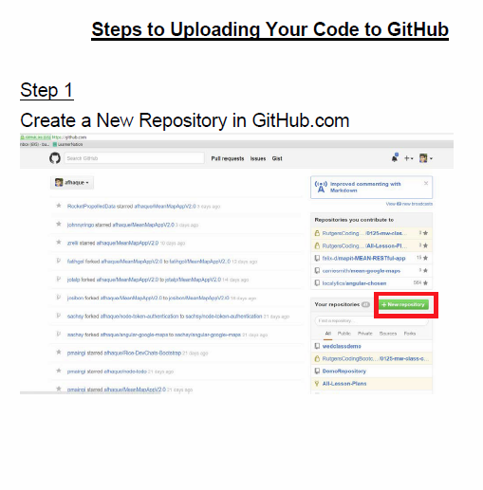
Still a Bit Lost? Never Worry!
Follow this handy Guide!
Practice a few times on your own before our next class.

Slide 42
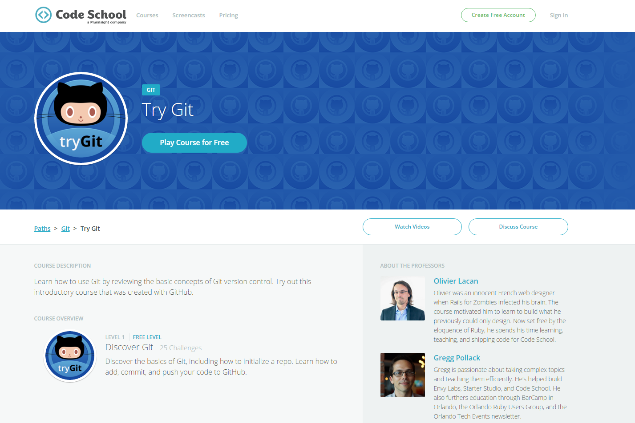
If You’re Still Lost… Here’s a (Free) Course
https://www.codeschool.com/courses/try-git

Slide 43
HTML Round 2

Slide 44
HTML Syntax (Basic)
Content
<h1>
This is Mah House
</h1>
Opening Tag
Closing Tag

Slide 45
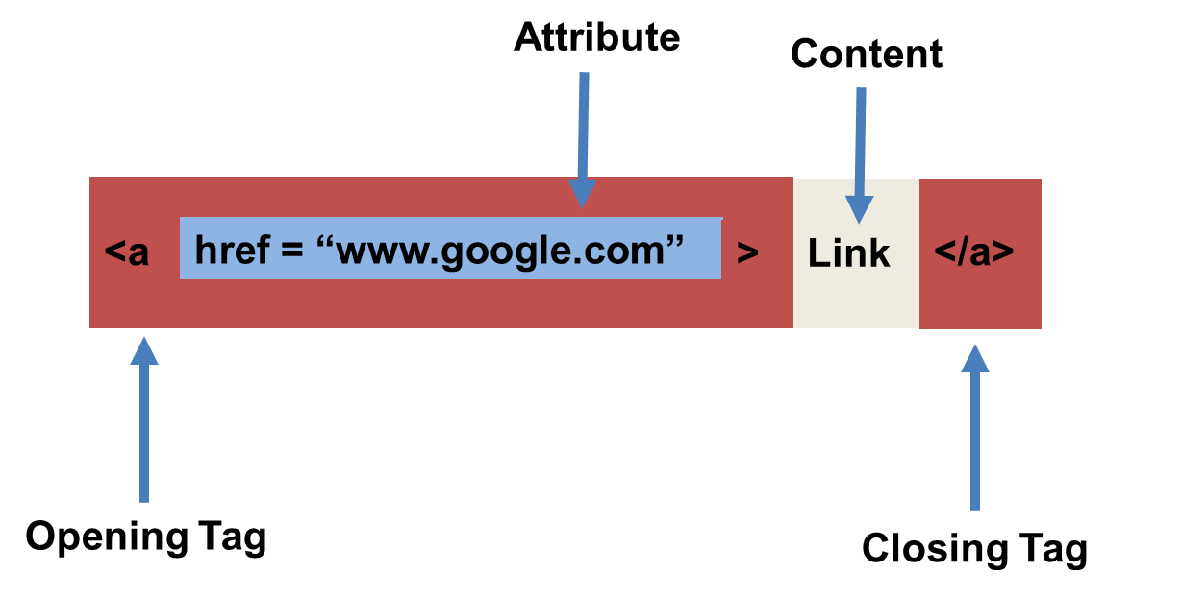
HTML Syntax (with Attribute)

Slide 46
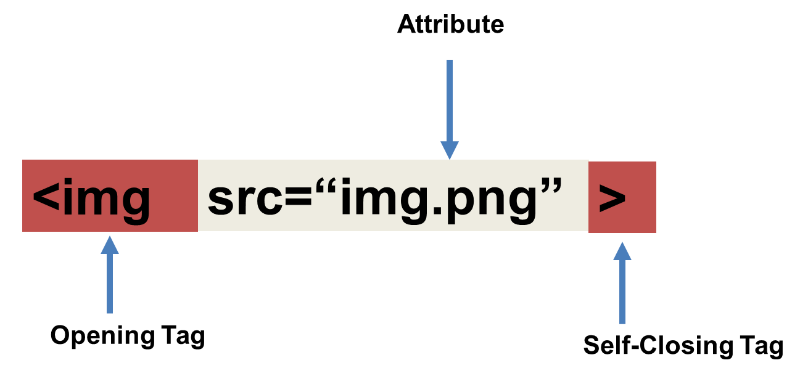
Tricky Tags (Self-Closing)

Slide 47
Important Common Tags
Headings:
<h1> </h1> - Heading 1 (Largest Heading)
<h2> </h2> - Heading 2 (Next Largest Heading)
<h3> </h3> - Heading 3
…
Containers:
<html> </html> - Wraps the entire page
<head> </head> - Wraps the header of the page
<body> </body> - Wraps the main content
<div> </div> - Logical Container ***
<p> </p> - Wraps individual Paragraphs
Others:
<strong> (bold), <em> (emphasis)
<img> (images), <a href> (links), <li> (list items) , <title> (title), <br> (line break), <table> (tables), <!-- --> (comments)

Slide 48
Less Common Tags
All HTML Tags are listed here: http://www.w3schools.com/tags/
Don’t try to memorize them! Simply refer back to documentation as needed.
Other tags:
<video> for Videos
<audio> for Audio files
<embed> for Embedded files
<code> for including computer code
<header> for headers
<nav> for navigation bars
<footer> for footers

Slide 49
HTML for Forms
Common UI (User Interface) Form Elements:
<form> - Creates a form section in HTML
<input> - Input boxes
<label> - Labels for boxes
<button> - Button
<textarea> - Large textbox

Slide 50
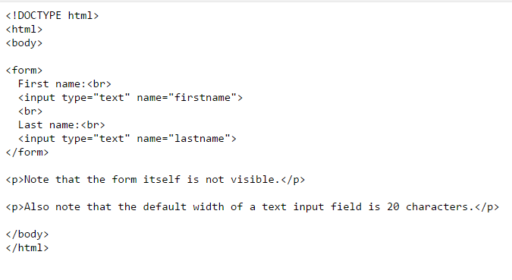
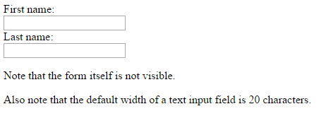
HTML for Forms

Slide 51
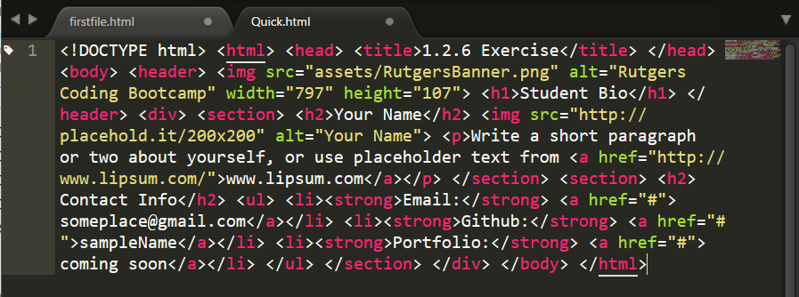
On Ugly HTML
Don’t do this… Use proper indentation and sectioning.
Readable code is easier to maintain.
Invest time to get better about this now. It will pay dividends!

Slide 52
> YOUR TURN!
Activity: 1-HTML_Git | Suggested Time: 20 min
Assignment
In this activity, you’ll create a student bio using HTML. You will then add, commit, and push your completed HTML to GitHub for the world to see.
Additional instructions, sent via Slack.

Slide 53
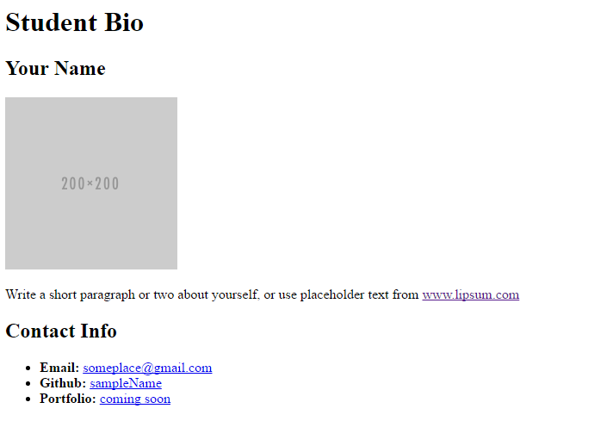
> YOUR TURN!

Slide 54
CSS Stylin’

Slide 55
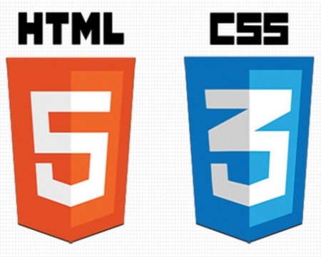

HTML / CSS Definitions (*yawn* unimportant)
HTML: Hypertext Markup Language – (Content)
CSS: Cascading Style Sheets – (Appearance)
HTML/CSS are the “languages of the web.” Together they define both the content and the aesthetics of a webpage – handling everything from the layouts, colors, fonts and content placement. (JavaScript is the third – handling logic, animation, etc.)

Slide 56


HTML / CSS Analogy
HTML Alone
Like writing papers in “Notepad.”
Can only write unformatted text.
HTML / CSS
Like writing papers in Microsoft Word.
Can format text, page settings, alignment, etc. based on “highlighting” and menu options.

Slide 57
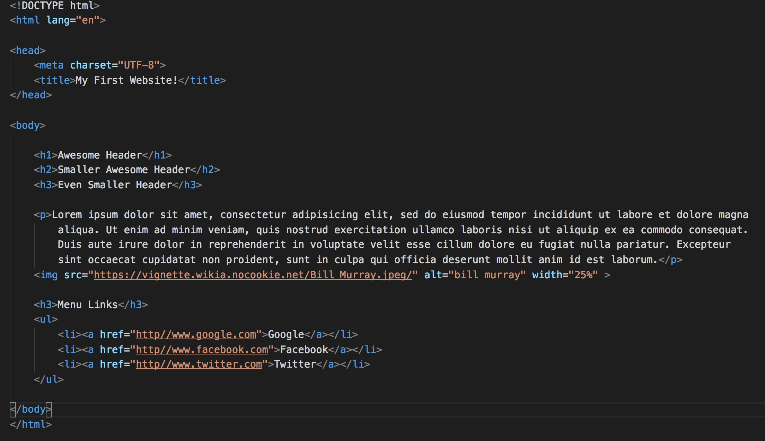
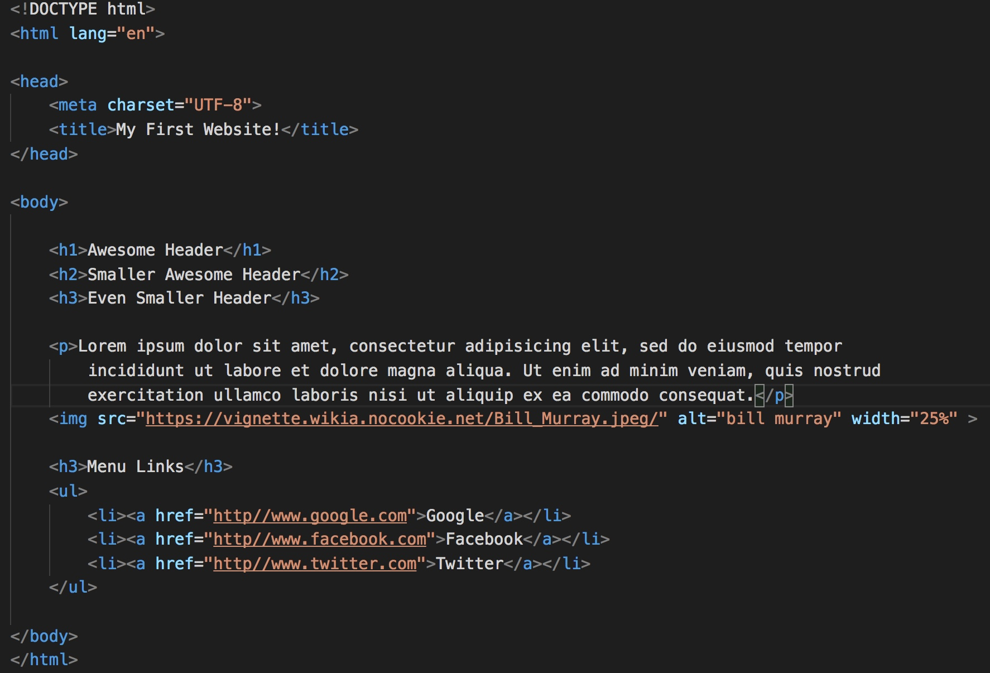
Basic HTML Page

Slide 58
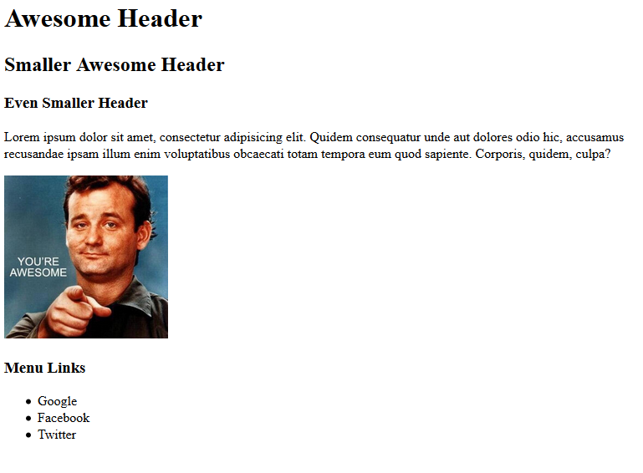
Basic HTML Page - Result

Slide 59
Basic HTML Page - Result
Hella Boring…

Slide 60
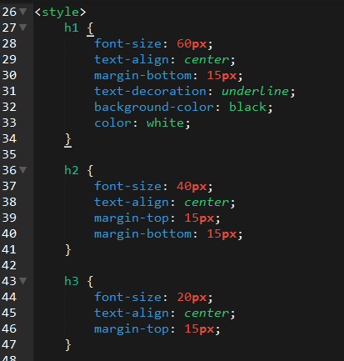
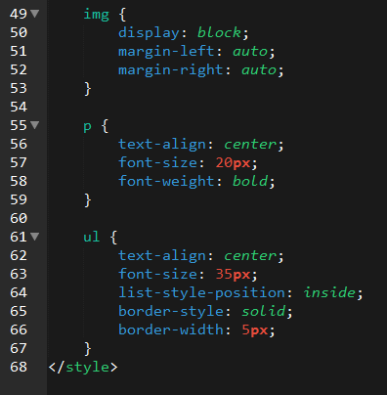
Enter CSS

Slide 61
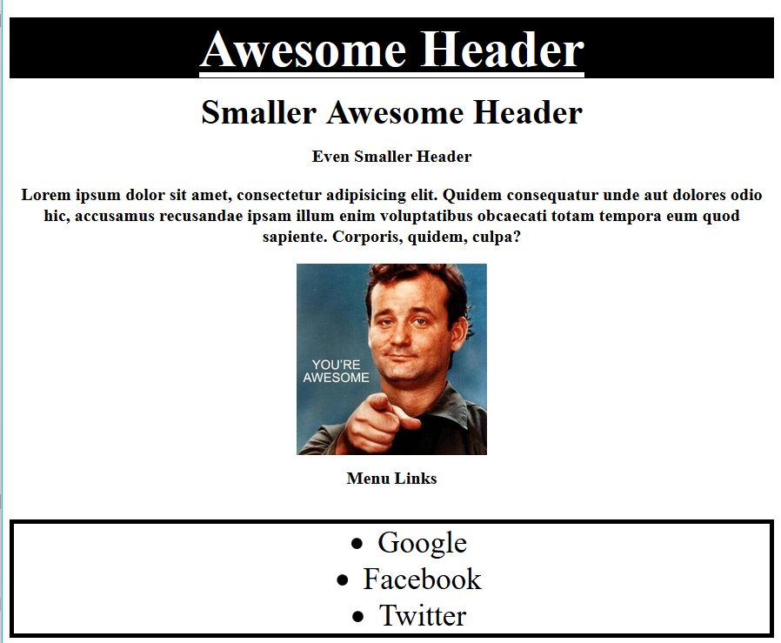
Enter CSS - Result

Slide 62
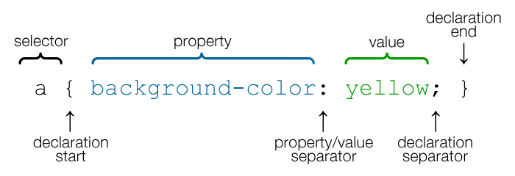
CSS Syntax
CSS works by hooking onto selectors added into HTML using classes and identifiers.
Once hooked, we apply styles to those HTML elements using CSS.

Slide 63
CSS Example
In the below example the “Header” would be turned blue and MUCH larger because of the CSS.
We can incorporate an element’s class or ID to apply a CSS style to a particular part of the document.
Just remember to include the necessary symbol before the CSS: “.” for class, “#” for ID.
Example (HTML):
<p class=“bigBlue”>Header</p>
Example (CSS):
.bigBlue
{
font-size: 100px;
color: blue;
}

Slide 64
Key CSS Attributes
Font / Color:
color: Sets color of text.
font-size: Sets size of the font.
font-style: Sets italics.
font-weight: Sets bold.
Alignment / Spacing:
padding (top/right/bottom/left): Adds space between element and its own border.
margin (top/right/bottom/left): Adds space between element and surrounding elements.
float: Forces elements to the sides, centers, or tops.
Background:
background-color: sets background color.
background-image: sets background image.

Slide 65
Powerful Duo
Believe it or not, HTML / CSS is all you need
to develop a vivid, full-blown website.

Slide 66
INSTRUCTOR DEMO
Instructor: Demo
(quickexample_internalcss.html | 2-BasicCSS)

Slide 67
> YOUR TURN!
Activity: 3-HTML_CSS_Layout | Suggested Time: 20 min
Assignment
In this activity, you’ll upgrade your previous HTML bio-page using CSS style rules. Once you’re done, commit and push up your changes to GitHub.
We’ll send you additional instructions via Slack.

Slide 68
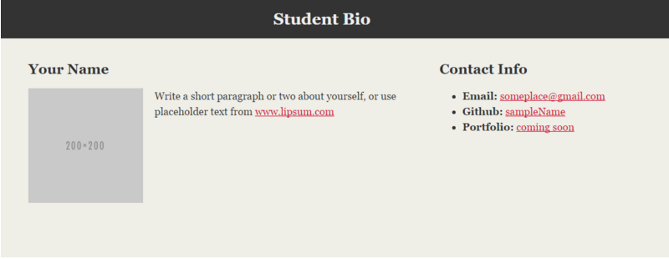
> YOUR TURN!

Slide 69
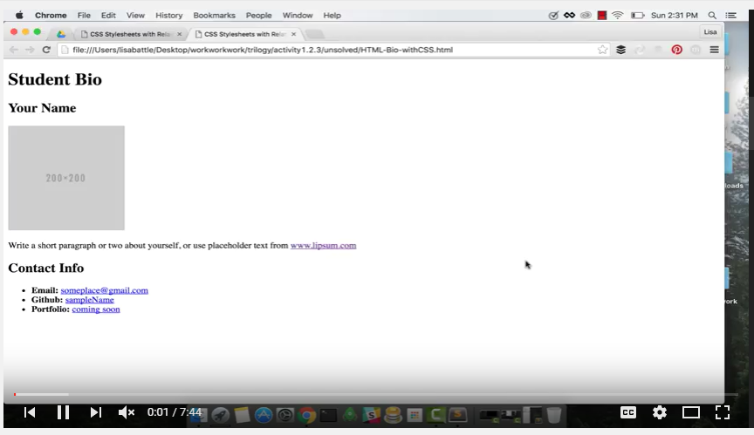
Video Walkthrough!!
https://www.youtube.com/watch?v=kMBinXTCrXI&list=PLgJ8UgkiorCnMLsUevoQRxH8t9bt7ne14&index=2

Slide 70

Still a Bit Confused?
Remember! We’ve got video guides for key activities like that last one.
If you feel like you are EVER falling behind, use those online walkthroughs to help catch back up. They are made to be easy to understand.
Still having trouble? Shoot your instructor or one of your TAs a message!
We are here to help you out in whatever way we can!

Slide 71
Recap + Questions

